Slide 1
System Development Methods CT00046-3-2
System Design – Part 2

Slide 2
Topic & Structure of the Lesson
Unified Modeling Language (UML) and examples of UML diagrams.
Concept of user interface design and Human-Computer Interaction (HCI), including basic principles of user-centered design.

Slide 3
Learning Outcomes
At the end of the module, you should be able to:
Describe the Unified Modeling Language (UML) and examples of UML diagrams.
Explain the concept of user interface design and human-computer interaction, including basic principles of user-centered design.

Slide 4
Key Terms you must be able to use
If you have mastered this topic, you should be able to use the following terms correctly in your assignments and exams:
UML and UML diagrams.
Concept of user interface design, human-computer interaction, and basic principles of user-centered design.

Slide 5
Unified Modeling Language (UML) and examples of UML diagrams

Slide 6
Influence of Software Design
Process Centered Design
Designing software based on automation of the process
Examples: Ticketing Machine, Manufacturing process, Hotel booking, etc.
Data Centered Design
Designing software based on processing large data.
Examples: Big Data, Shopping, Immigration system, flight management.
User Centered Design
Designing software based on human behavior
Examples: AI, games, social sites, navigation applications, etc.

Slide 7
Unified Modeling Language (UML)
Unified Modeling Language (UML) is a widely used method of visualizing and documenting software systems design.
UML uses object-oriented design concepts, but it is independent of any specific programming language and can be used to describe business processes and requirements generally.
UML can be used to design, discuss, present and event test a software component before its built.

Slide 8
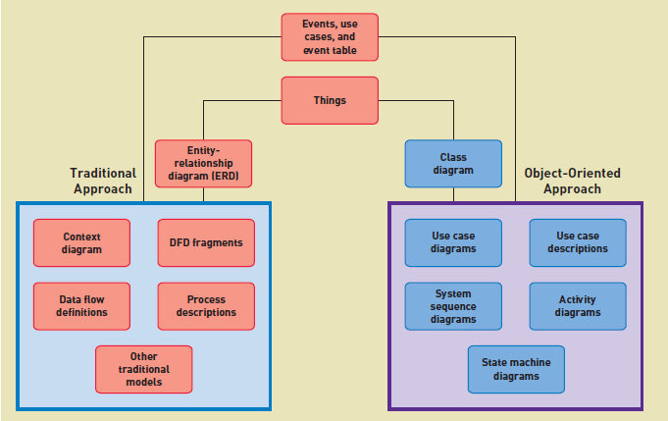
Unified Modeling Language (UML) Traditional versus Object-Oriented Approaches

Slide 9
Unified Modeling Language (UML) TWO different views of UML diagrams
Static / Structural view
Emphasizes the static structure of the system using objects, attributes, operations and relationships.
Used for data and process-oriented development approach.
Presented through - class and entity relationship diagrams.
Dynamic / Behavioral view
Emphasizes the dynamic behavior of the system by showing collaborations among objects and changes to the internal states of objects.
Used for a user and some process-oriented development approach.
Presented through sequence diagrams, activity diagrams and state machine diagrams.

Slide 10
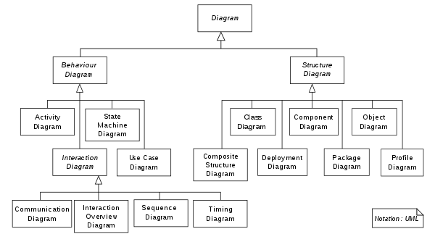
Unified Modeling Language (UML) TWO different views of UML modeling

Slide 11
Examples of UML Diagrams
Behaviour Diagrams
An Activity diagram represents workflows in a graphical way.
Describes the business workflow or the operational workflow of any component in a system.
A State machine diagram is similar to an activity diagram.
Known as a state diagram or state chart diagram.
Describes the behavior of objects that act differently according to the state they are in now.
A Use case diagram gives a graphic overview of the actors involved in a system,
Shows different functions needed by those actors and how these different functions interact.
A Sequence diagram shows how objects interact with each other and the order in which those interactions occur.

Slide 12
Examples of UML Diagrams
Structure Diagrams
A class diagram is the main building block of any object-oriented solution.
It shows the classes in a system, attributes, and operations of each class and the relationship between each class.
A component diagram displays the structural relationship of components of a software system.
Mostly used when working with complex systems with many components
A deployment diagram shows the hardware of your system and the software in that hardware.
Useful when your software solution is deployed across multiple machines with each having a unique configuration.
Object Diagram referred to as Instance diagram - very similar to class diagrams.
Show the relationship between objects, but they use real-world examples.

Slide 13
Concept of user interface design and human-computer interaction, including basic principles of user-centered design.

Slide 14
User Interface Design
A user interface (UI) describes how users interact with a computer system, and consists of all the hardware, software, screens, menus, functions, output, and features that affect two-way communications between the user and the computer.
Three aspects of the user interface:
Perceptual Aspects
What the user sees, hears, touches
Screen objects, buttons
Physical Aspects
Devices used
Documents, Forms
Conceptual Aspects
What the user understands about the system

Slide 15
User-Centered Design Principles
Understand the Business
Understand the underlying business functions and how the system supports individual, departmental, and enterprise goals.
Maximize Graphical Effectiveness
A well-designed interface can help users learn a new system rapidly and be more productive.
Think Like a User
The interface should be flexible enough to accommodate novices as well as experienced users.
Use Models and Prototypes
Construct models and prototypes for user approval.
The overall objective is to design an interface that helps users to perform their jobs.
An interface designer should obtain as much feedback as possible, as early as possible.

Slide 16
User-Centered Design Principles (continued)
Focus on Usability
Include all tasks, commands, and communications between users and the information system.
Invite Feedback
Even after the system is operational, it is important to monitor system usage and solicit user suggestions.
Document Everything
Document all screen designs for later use by programmers.
You can determine if system features are being used as intended by observing and surveying users.
User-approved sketches and storyboards also can be used to document the user interface.
If you are using a CASE tool or screen generator, number the screen designs and save them in a hierarchy like a menu tree.

Slide 17
Human Computer Interaction (HCI)
A user interface is based on basic principles of human-computer interaction. Human-computer interaction (HCI) describes the relationship between computers and people who use them to perform their jobs.
HCI concepts apply to everything from PC desktops to global networks. In its broadest sense, a user interface includes all the communications and instructions necessary to enter input to the system and to obtain output in the form of screen displays or printed reports.
Concepts of creating software that is safe and pleasant to use.

Slide 18
Human Computer Interaction (HCI) (continued)
As a systems analyst, you will design user interfaces for in-house developed software and customize interfaces for various commercial packages and user productivity applications. Your main objective is to create a user-friendly design that is easy to learn and use.
Things to consider in HCI:
Users' abilities/ disabilities
User’s age group (interest, legal contents, etc.)
User’s computer literacy (Novice, Intermediate, Expert)
User’s Socio-culture (perception of color, language, religious sensitivity, etc.)
Purpose of Software (Command line, GUI, Interactive, 3D, etc.)

Slide 19
Summary
Unified Modeling Language (UML) is a method of visualizing and documenting software systems design. UML uses object-oriented design concepts, but it is independent of any specific programming language.
UML static diagrams emphasize the static structure of the system using objects, attributes, operations, and relationships. Used for data and process-oriented development approach.
UML behavioral diagrams emphasize the dynamic behavior of the system by showing collaborations among objects and changes to the internal states of objects. Used for a user and some process-oriented development approach.
System user interface is based on basic principles of human-computer interaction that describe the relationship between computers and people who use them to perform their jobs.
The user-centered design aim is to design an interface that helps users to perform their jobs and based on perceptual, physical, and conceptual aspects.

Slide 20
Question & Answer

Slide 21
Next Session
System Implementation

